Slide 1
Name: Swapnil Ghosh
Group: A2
Roll: 001911001067
TASK 9

Slide 2
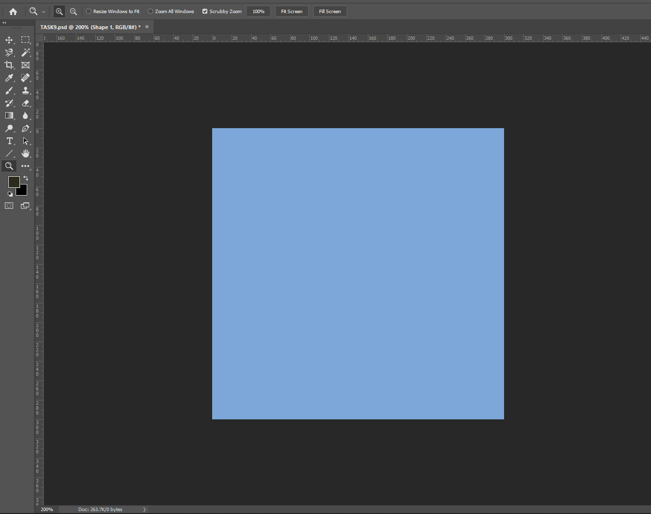
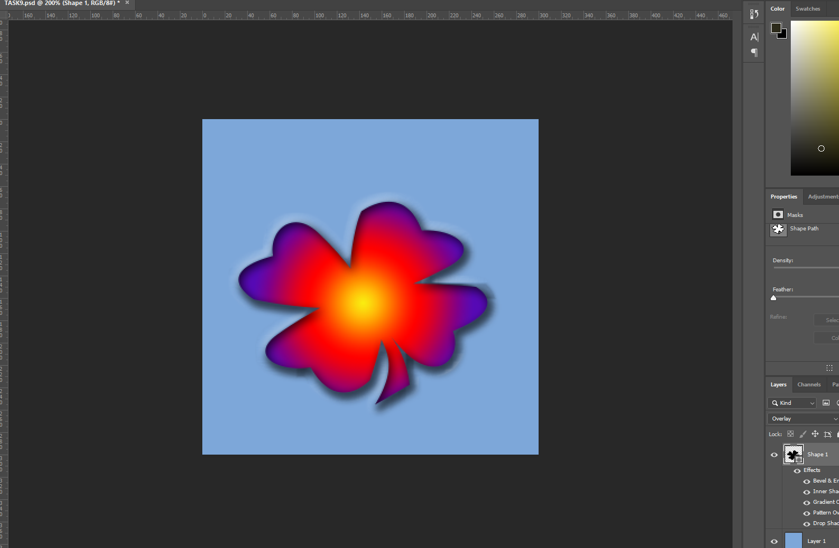
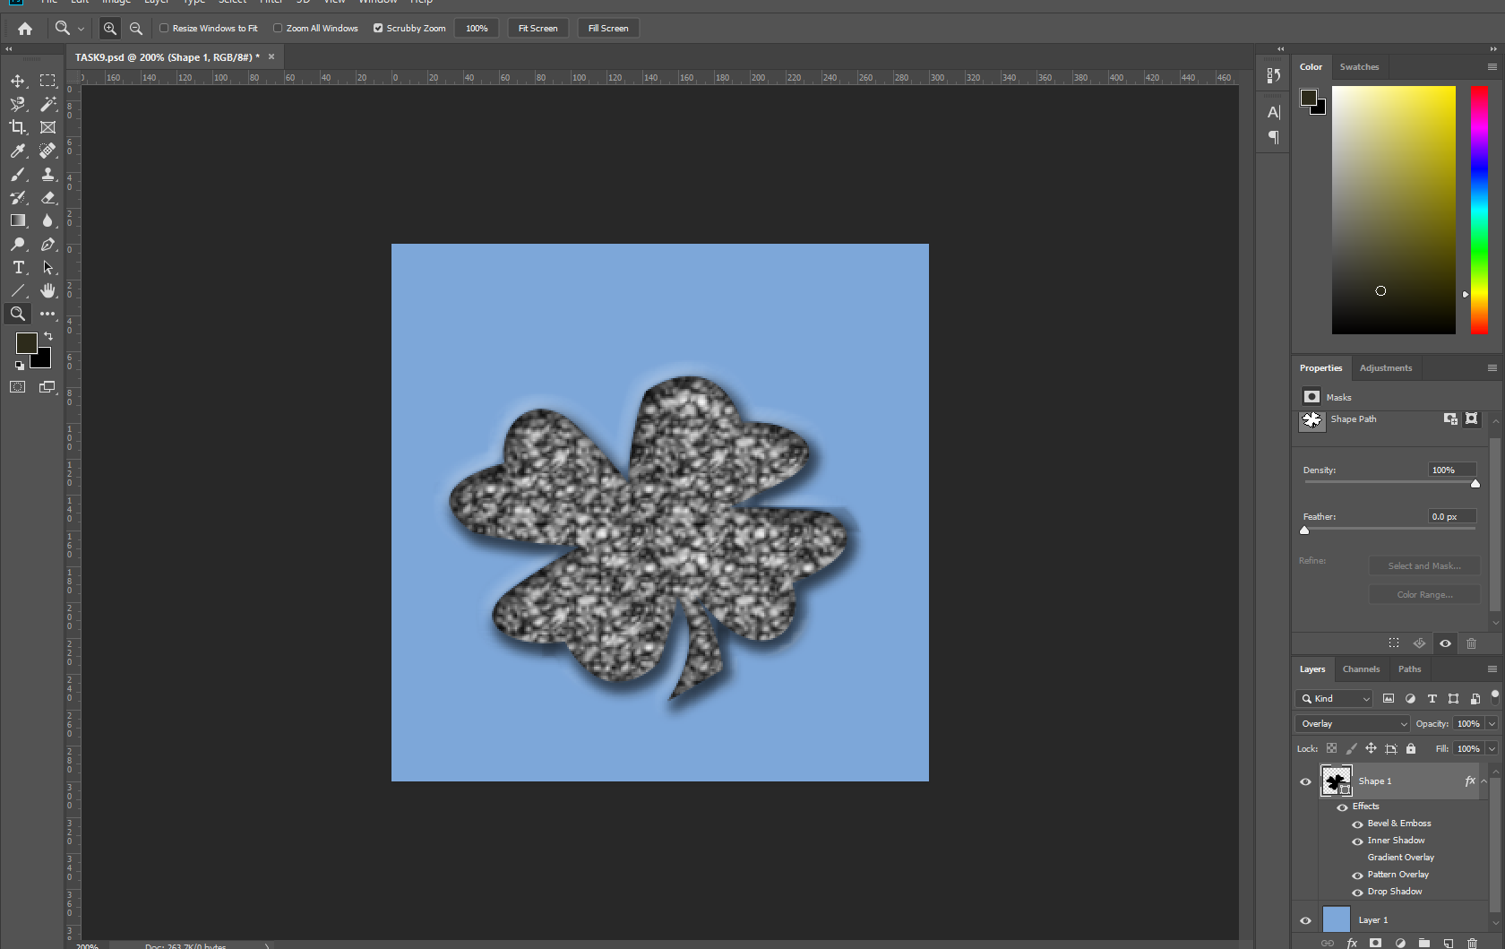
Step-1) Created a new image 300 by 300 in dimensions and Fill it with color pastel cyan blue from Swatches palette.
Step-2) Selected Custom Shape tool and created a New Shape Layers and choose black as foreground color.
Step-3) Selected a shape from the Shapes palette and dragged to create the shape on the canvas.
Step-4) Selecting the Shapes layer applied the following layer styles : pattern overlay, bevel and emboss (outer bevel).

